Slide 1
Time Management Application
CS/SE/CE 3354 Software Engineering
Group Members:
Alex Countryman, Alex Tang, Aston Esquivel, Chris Cowan, Faizan-Ali Lalani, Griffin Tamm, Lawrence Ho, Michael Zeller, Yousef Ali

Slide 2
Objectives
Deadline Management:
Enable users to add, edit, and delete task deadlines
Task Prioritization:
Implement a sorting algorithm to prioritize tasks based on:
Deadline proximity
Task complexity
Other relevant metrics
User Interface:
Provide an intuitive, easy-to-navigate calendar interface
Ensure smooth transitions between month, week, and day views
Data Persistence:
Store user data securely to maintain task and deadline information across sessions
Notification Pushes:
Notifications pushed to users daily based on upcoming deadlines and activities

Slide 3
Project Timeline
03
04
05
W1
W2
W3
W4
W1
W2
W3
W4
W1
W2
W3
W4
Requirement Gathering and Planning
Design Planning
Development and Testing
Deployment and Final Adjustments
Sprint 1
Tasks
Sprint 2
Calendar
Sprint 3
Task category and view display
Sprint 4
Notifica-
tions
Sprint 5
Testing,
tech-debt, QA

Slide 4
Software Process Model
Use of Agile Scrum:
Flexibility
Requirements may evolve throughout the development process
Especially at the end stages due to frequent IOS and Android system changes
Prioritization of essential features
Deliver value incrementally
Focus on collaboration and adaptability
Streamline development
Maintain high-quality product tailored to user feedback
To ensure the product adapts to changing needs, it emphasizes:
Collaboration
Continuous feedback
Iterative development
Product is targeted to be a free application at launch
Cost-efficiency is crucial

Slide 5
Functional Requirements
The time management application shall:
Allow users to create a “Time Block”
Contains a title, description, duration, time, date
Optionally allow a user to add a course name/number
Allow users to create a “Task”
Contains a title, due date, time, and complexity
Complexity is an integer user input between 1 - 5 (1 = lowest complexity and 5 = highest complexity)
Display both Tasks and Time Blocks on a calendar view
Month, week, or daily views, where users can switch between periods of dates
Generate and show a priorities list view
“Upcoming” list is ranked based on the task/activity due date
“Urgent tasks” list is ranked based on urgency
Urgency is based on time remaining and complexity
Generate notifications for users daily based on urgency value of tasks

Slide 6
Non-functional Requirements
Usability requirements
Must be a mobile based app distributed publicly by Google Play Store and Apple App Store
Must be offered on most mainstream devices (IPhone, Galaxy, etc) in the last 5 years
Performance Requirements
Must have less than half a second load time into application
Space Requirements
Must take less than 400Kb of storage on user’s device
Must take less than 200Kb of ram on user’s device
Dependability Requirements
Must crash or terminate less than 0.1% of application startups
Environmental Requirements
Must only send notifications between 10:00AM - 7:00PM user time
Operational Requirements
Must operate in any user operations as long as the application is open
Must push notifications while user’s device isn’t displaying application
Development Requirements
Must predominantly use either Java or Swift
Must produce short description for every file created in documentation

Slide 7
Non-functional Requirements (cont.)
Accounting Requirements
Application must be free in every country the application is available
Ads must be kept to the minimum threshold to meet the cost of development within 5
years
Safety/security requirements
User data must be backed up to a server with every application use
Any data saved must be encrypted using industry standards
Ethical requirements
The app must get the consent of the user to collect all data and provide clear instructions on how that data will be used
Any and all user data collected must not be used for profit
Regulatory Requirements
Must follow applicable laws to every country the app is available to

Slide 8
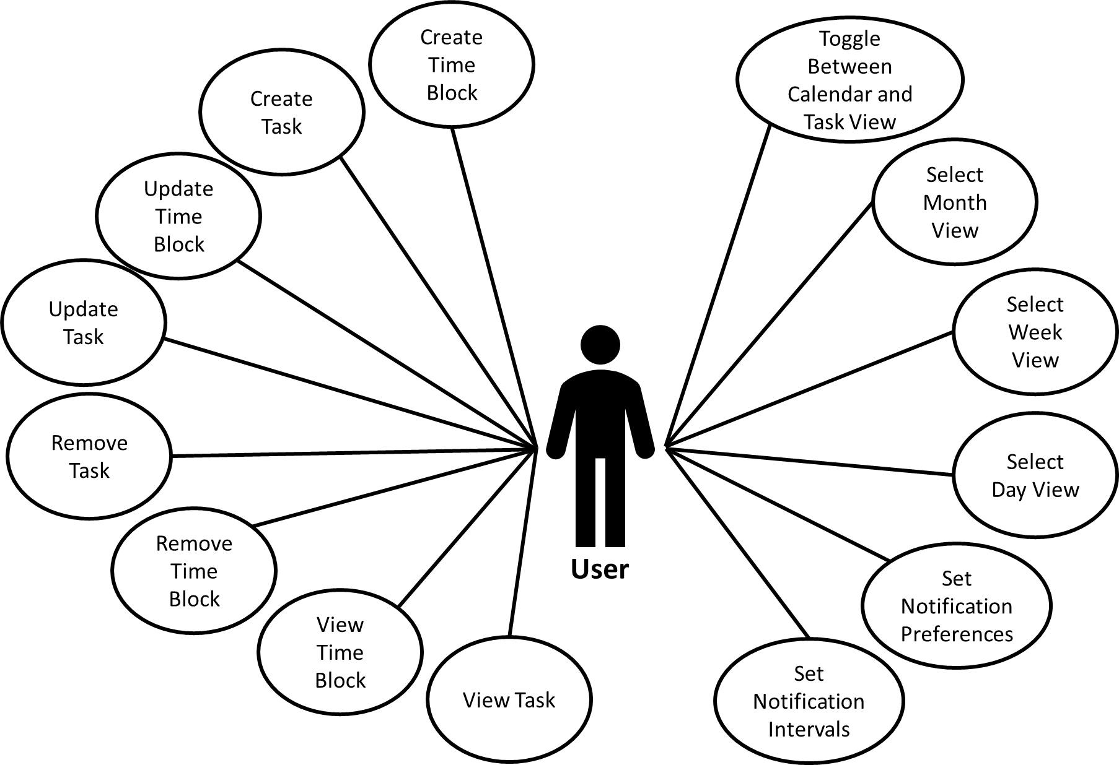
Use Case Diagram

Slide 9
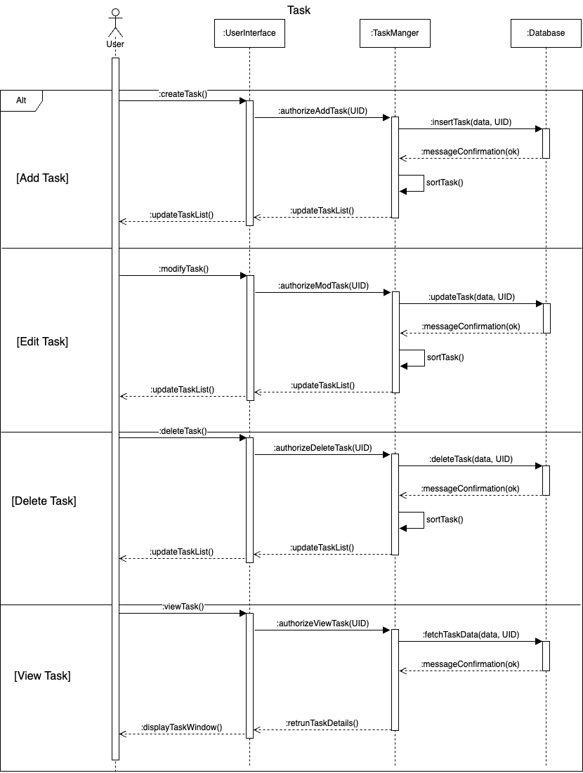
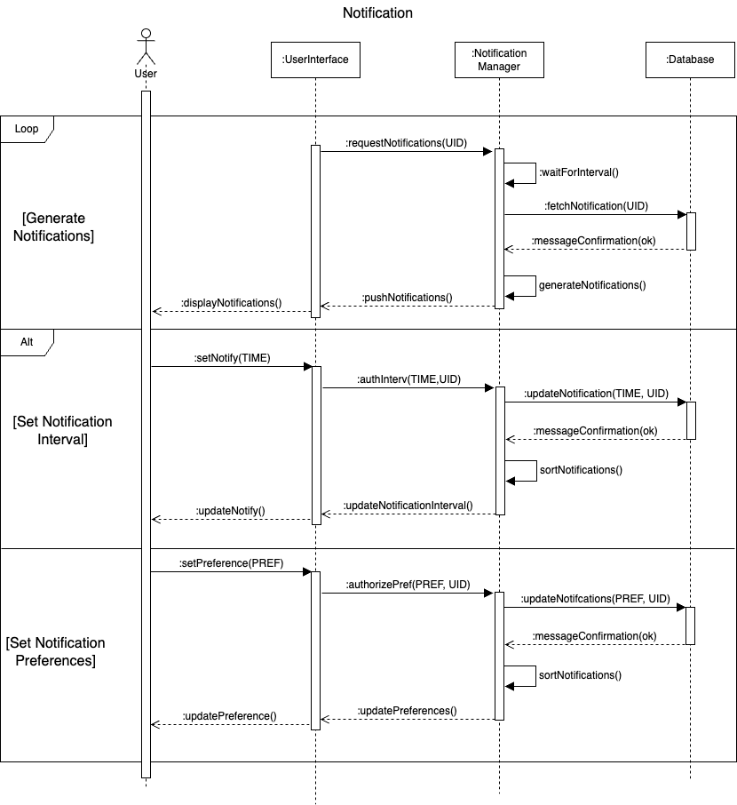
Sequence Diagrams

Slide 10
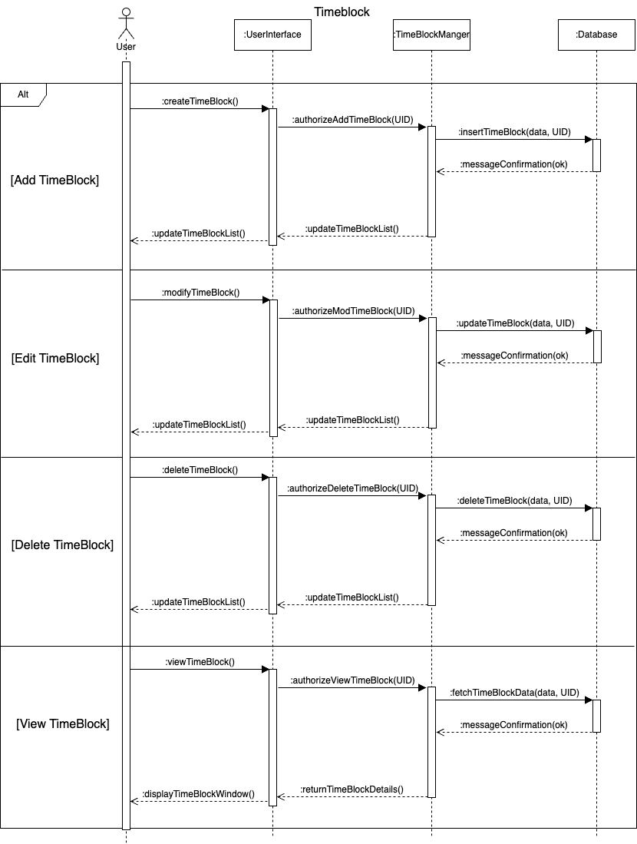
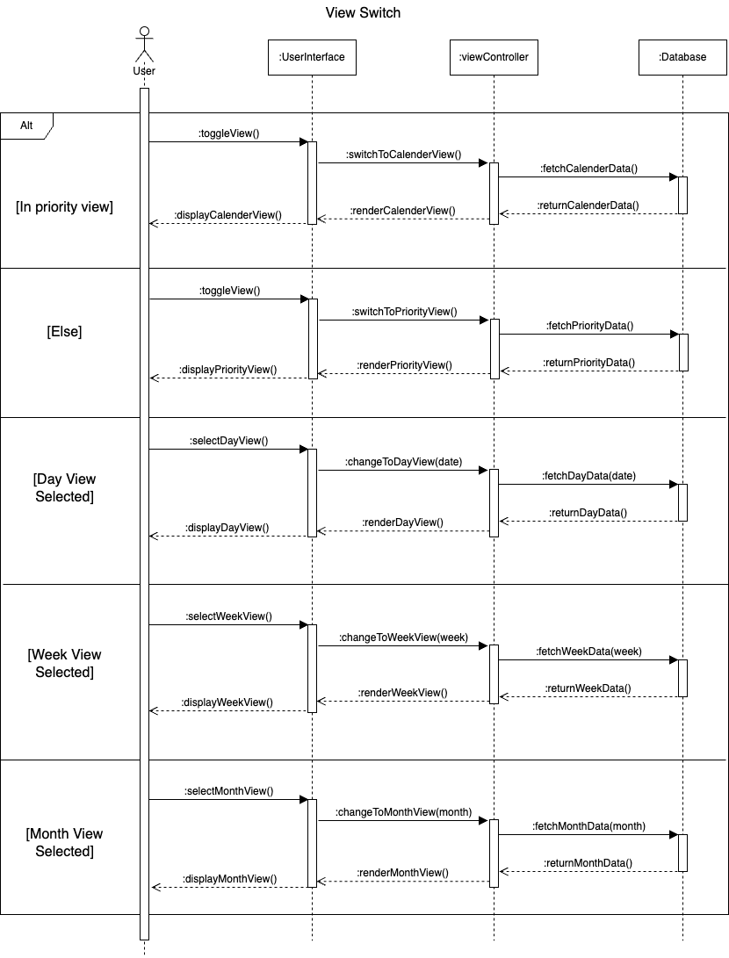
Sequence Diagrams (cont.)

Slide 11
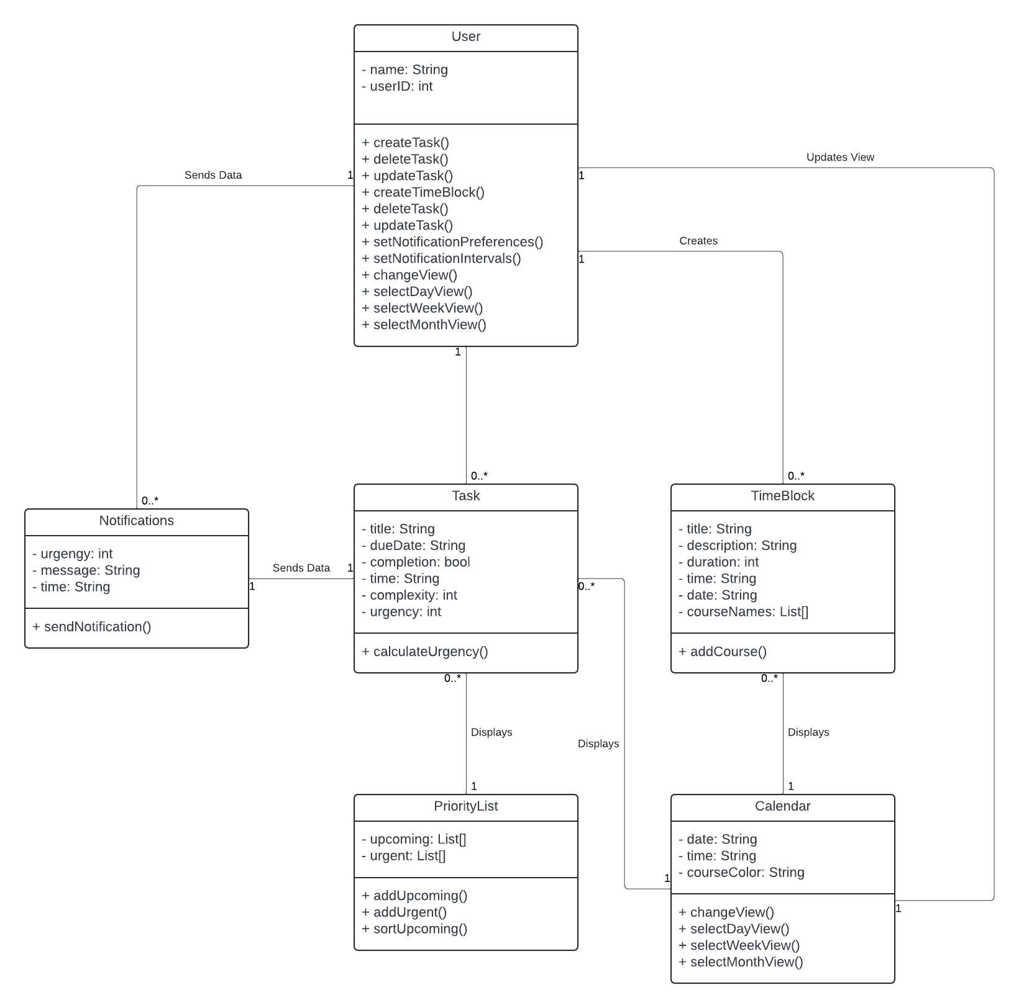
Class Diagram

Slide 12
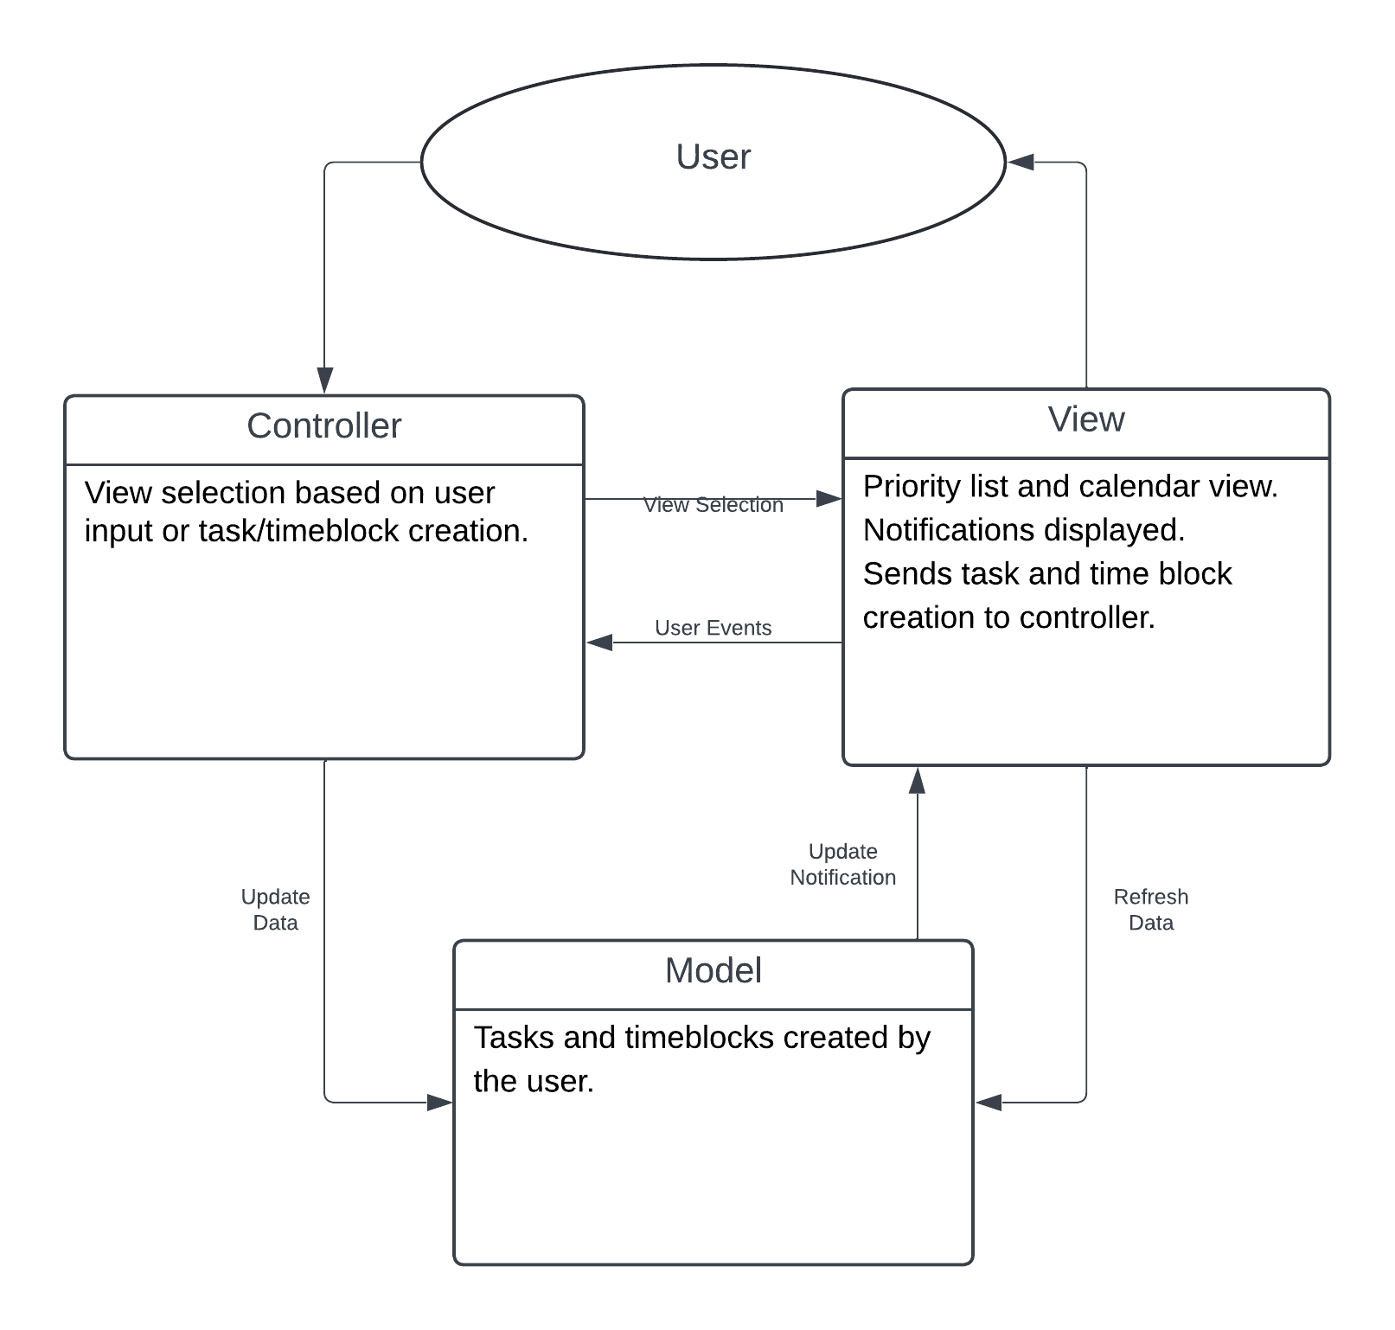
Architectural Design

Slide 13
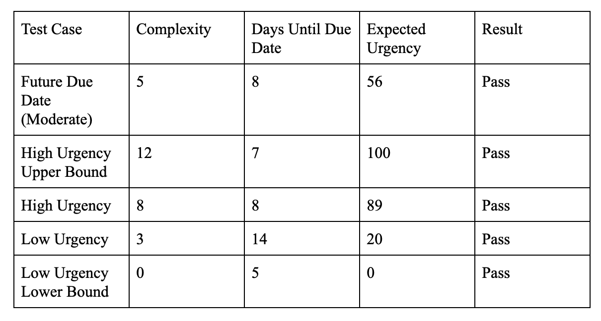
Software Testing
Calculate Urgency Method Testing
Types of testing
Functional Testing
Boundary Testing (Edge cases)

Slide 14
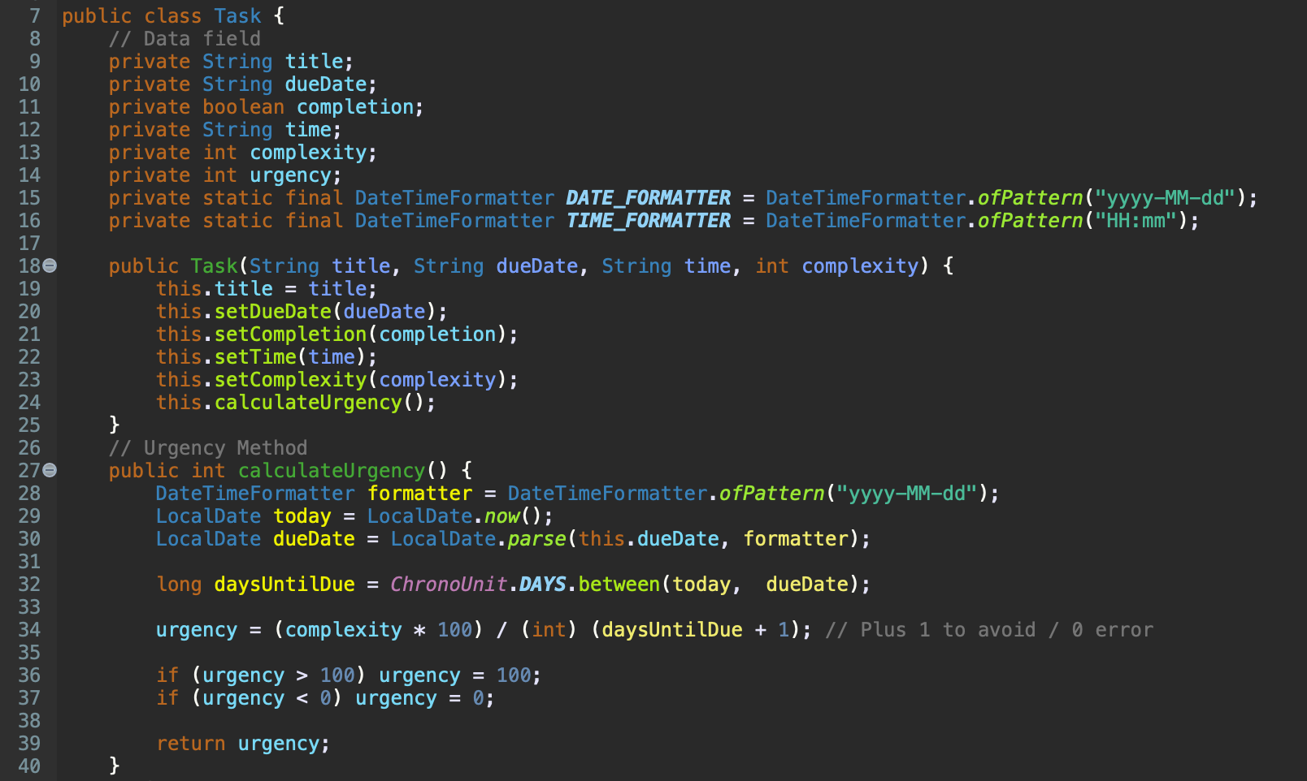

Slide 15
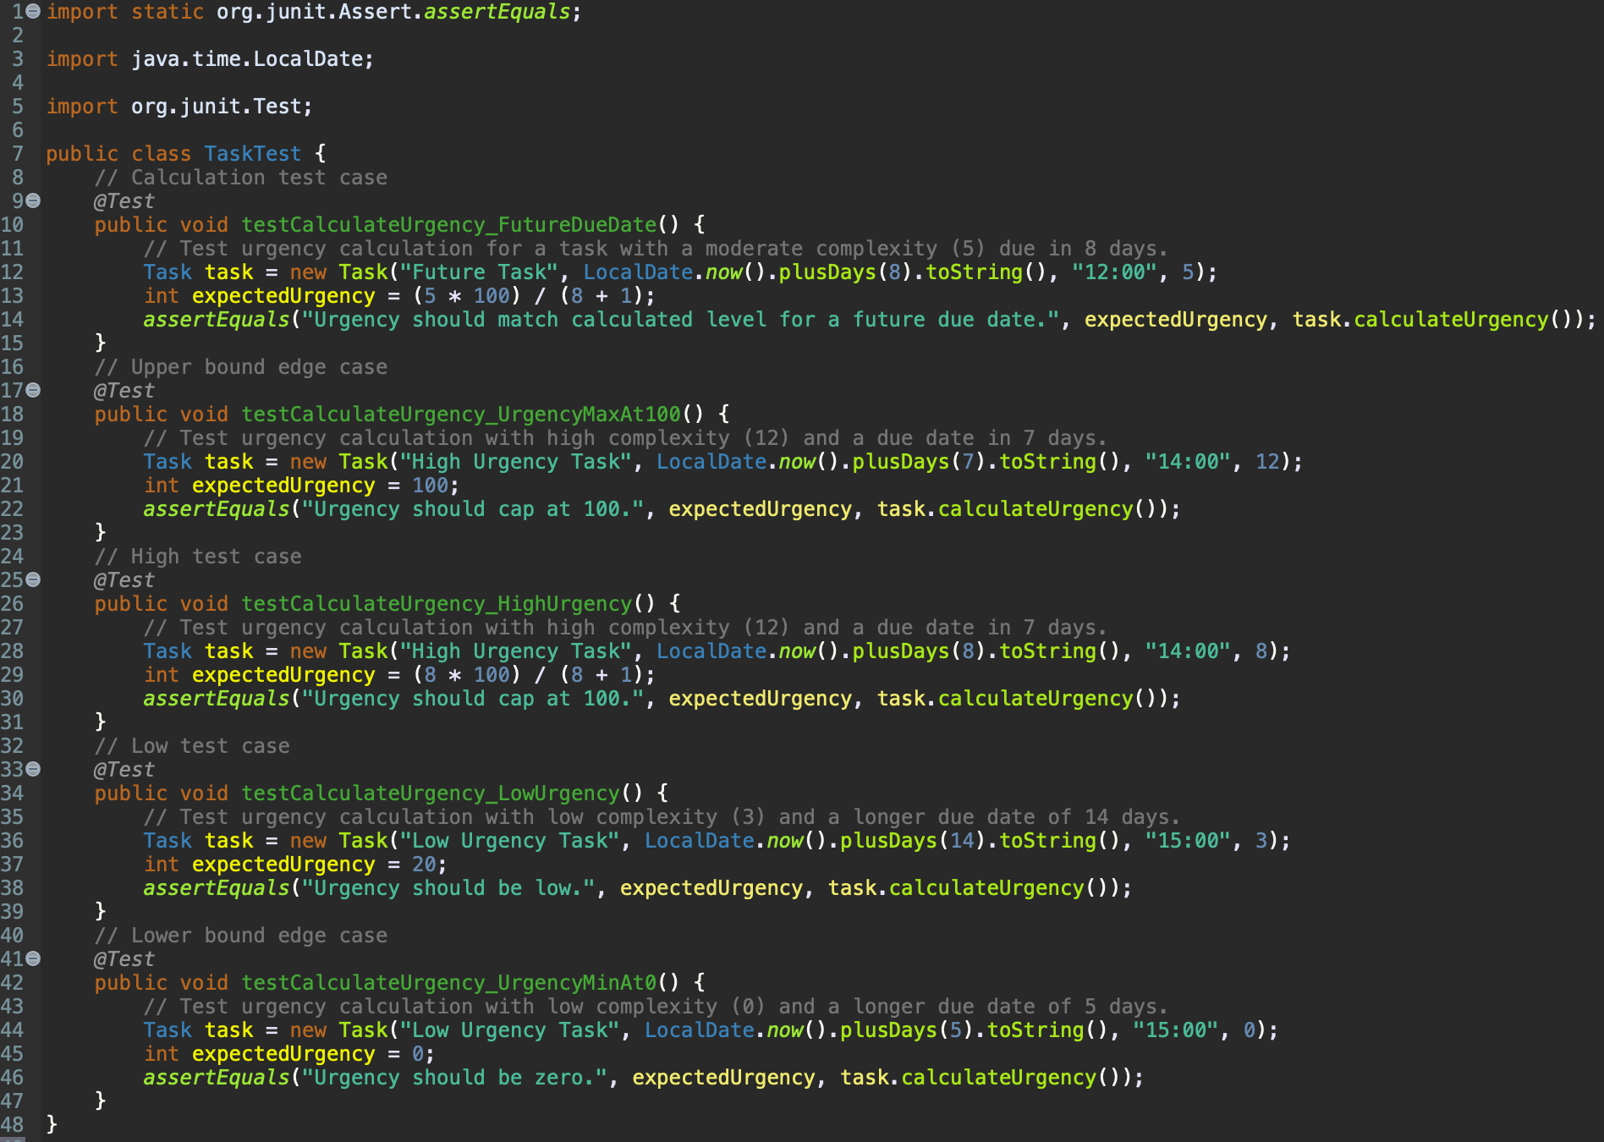

Slide 16
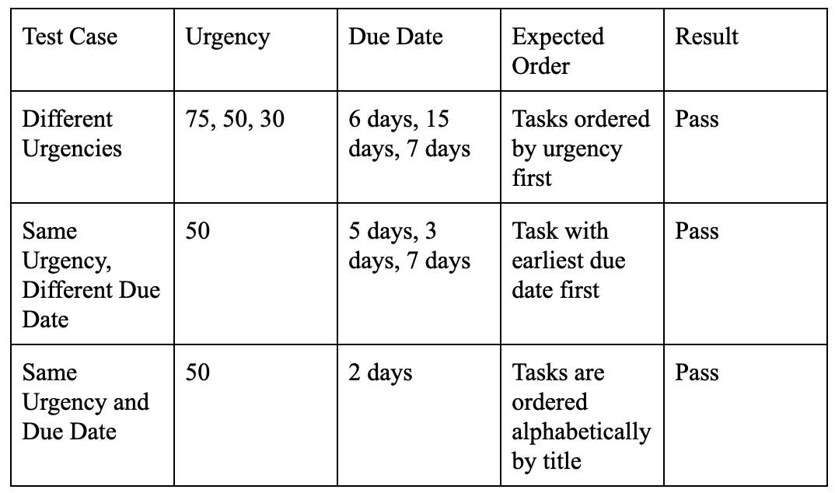
Software Testing
Task Manager (Priority Queue) Data Structure Testing
Types of testing
Functional Testing

Slide 17
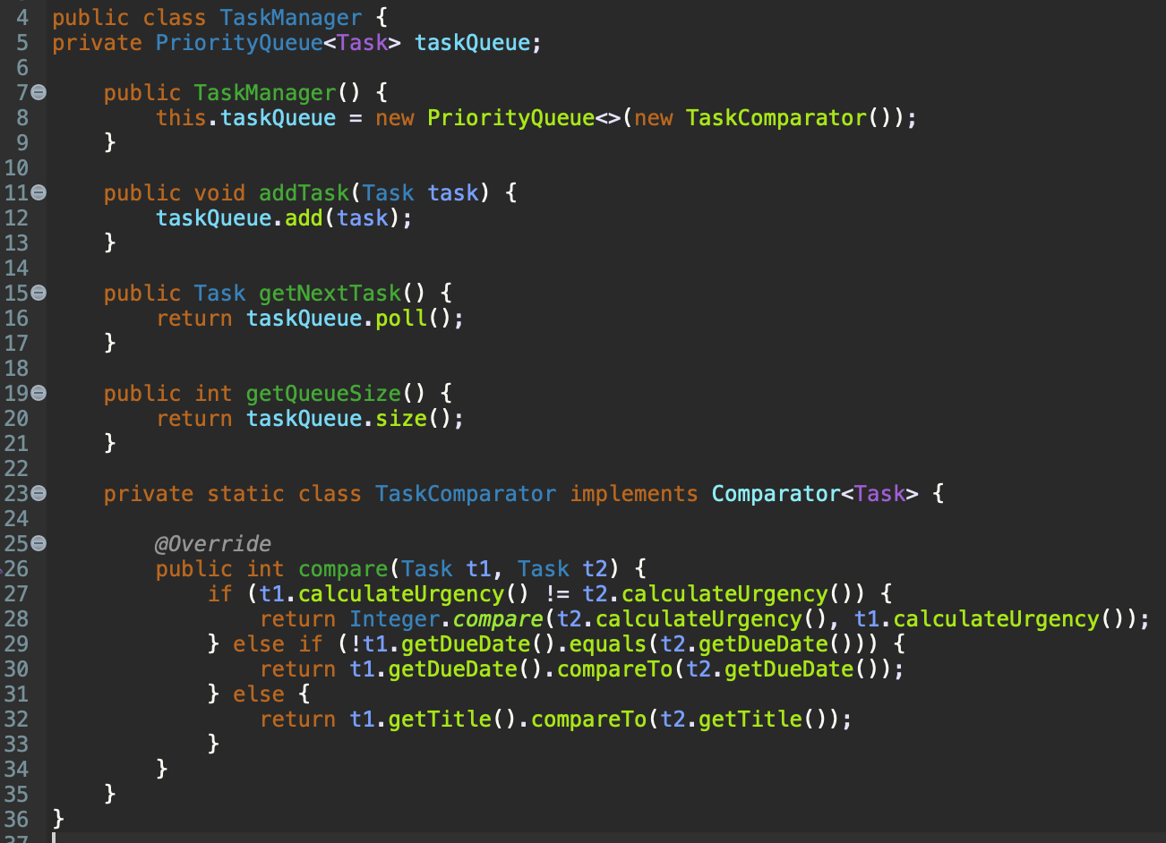

Slide 18
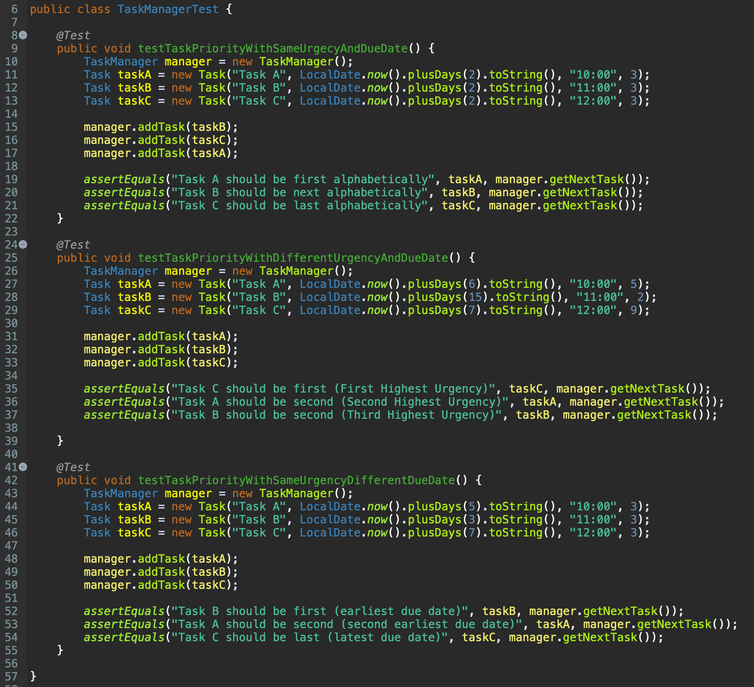

Slide 19
Cost, Effort, and Pricing Estimation
PCA = 0.65 + 0.01 (Total PC)
= 0.65 + 0.01 (34)
= 0.99
FP = GFP * PCA
= 244 * 0.99
= 241.56 FP
E = FP / productivity
= 241.56 / 4.392
= 55 person-weeks
D = E / team size
= 55 / 5
= 11 weeks
 | Function Category | Count | Complexity |  |  | Count x Complexity
 |  |  | Simple | Average | Complex
1 | Number of user input | 29 | 3 | 4 | 6 | 87
2 | Number of user output | 11 | 4 | 5 | 7 | 55
3 | Number of user queries | 6 | 3 | 4 | 6 | 18
4 | Number of data files and relational tables | 8 | 7 | 10 | 15 | 56
5 | Number of external interfaces | 4 | 5 | 7 | 10 | 28
 |  |  |  |  | GFP | 244
Notes:
Mention PC calculation during presentation

Slide 20
Estimated Minimum Total Cost ≈ $195,835
Estimated cost of personnel
Average pay of a junior SWE = $37.45 per hour * 2 people
Average pay of a senior SWE = $74.59 per hour * 3 people
Average pay of a scrum master = $51.94 per hour * 1 person
Average pay of a product owner = $51.69 per hour * 1 person
Total number of hours = 11 weeks * 40 hrs/wk = 440 hrs
Estimated $10,000 for additional employee training
Total personnel cost = 2 ($37.45 * 440) + 3 ($74.59 * 440) + ($51.94 * 440) + ($51.69 * 440) + $10,000
= $187,012
Estimated cost of Hardware Products
Web server/Database (cloud-based service)
Cost based on DB instances (e.g., AWS can be $.011 per DB instance hour)
Amount from $100 to thousands depending on the popularity of the app
Workstation for 5 developers
5 MacBook Pros = $1,738 * 5 ≈ $8,700
Internet - Remote developers bear costs
Estimated cost of Software Products
Version Control and Repository
Git/GitHub is free
IDE
5 Copies of XCode, which is free
Project Management
Jira. 3 Months of development at $7.53/Month ≈ $23

Slide 21
Comparison to Other Works
Shared features
Task manager,calendar, and deadline tracking
Advantages of Todoist
Recurring task due dates for streamlined scheduling
Subtasks and sections to break down large tasks
Labels for task categorization and organization
Bird’s-eye view of schedule with easy task filtering
Advantages of Moday.com
Customizable and collaboration-friendly
Advanced scheduling tools & detailed task tracking
Integrations for broader functionality
Advantages of google calendar
Task & calendar management, integrated with other Google services
Auto-sync with emails and meeting schedules
Our focus
Prioritizes User-Friendliness over Complexity
Conclusion: Our project emphasizes user-friendliness over complexity, while Todoist, Monday.com, and Google Calendar offer more advanced features and options for task filtering, collaboration, and integration.

Slide 22
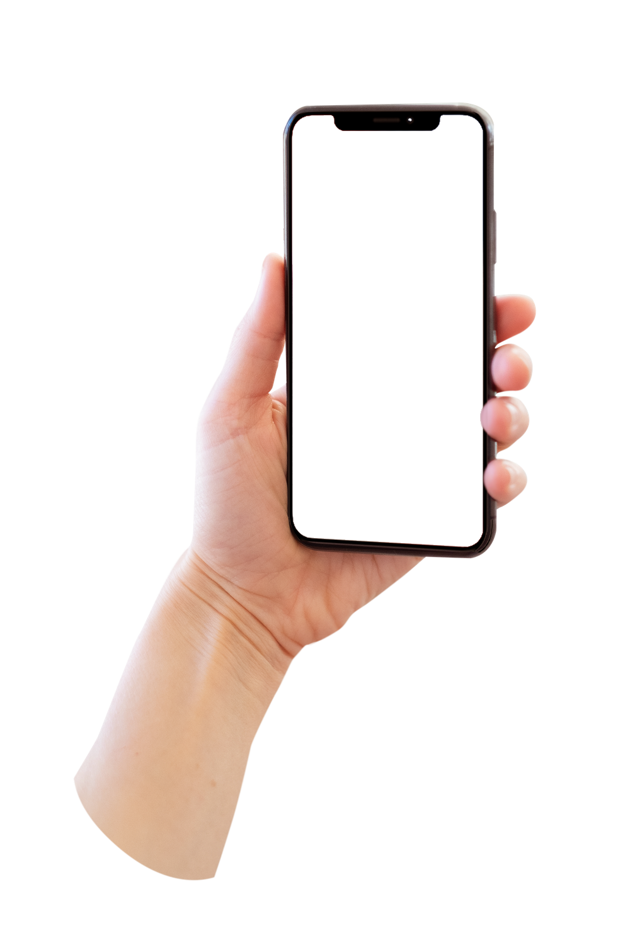
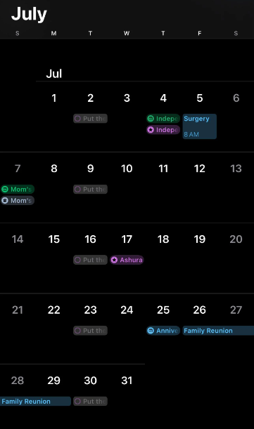
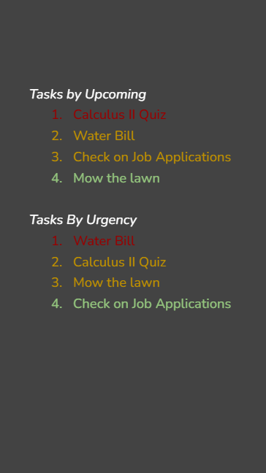



Demo of UI

Slide 23
Conclusion
Our team aimed to create a time management app to streamline task scheduling and improve productivity. Initially, we focused on simplicity, but later expanded to include both a calendar view and priority list, giving users versatile options for viewing tasks.
We added calendar transitions (monthly, weekly, daily) and urgency-based notifications to enhance user engagement and make task management more intuitive. Routine task management was considered but deprioritized to keep the app efficient and focused on immediate needs.
Through detailed testing with JUnit, we ensured reliable functionality. Overall, the project met its core objectives, with room to add routine scheduling for further customization. Agile development allows our app to evolve and grow with user needs.

Slide 24
References
[1] I. Kurkina, “Average Cloud Computing Costs for Small Businesses,” Academy SMART, Aug. 11, 2023. https://academysmart.com/insights/average-cloud-computing-costs-for-small-businesses/
‌[2] Apple, “MacBook Pro,” Apple, 2023. https://www.apple.com/macbook-pro/
[3] Atlassian, “Jira Pricing - Monthly and Annual” https://www.synthesia.io/learn/training-videos/training-cost
[4] “Junior Software Engineer salary (November 2024),” Zippia, https://www.zippia.com/salaries/junior-software-engineer/ (accessed Nov. 8, 2024).
[5] “2022 Senior Software Engineer Salary in US (Updated Daily) | Built In,” builtin.com. https://builtin.com/salaries/dev-engineer/senior-software-engineer
[6] “2022 Scrum Master Salary in US (Updated Daily) | Built In,” builtin.com. https://builtin.com/salaries/project-mgmt/scrum-master
[7] “2023 Product Owner Salary in US (Updated Daily) | Built In,” builtin.com. https://builtin.com/salaries/product/product-owner
[8] K. Alster, “How much does employee training cost? (2024 Guide),” www.synthesia.io, 2024. https://www.synthesia.io/learn/training-videos/training-cost
[9] “Features,” Todoist, https://todoist.com/features
[10] Monday.com, “monday - team management software | monday.com,” monday.com, 2023. https://monday.com/
[11] “What can you do with Calendar? - G Suite Learning Center,” support.google.com. https://support.google.com/a/users/answer/9302892?hl=en

